Slide 1
C++ Pointers
Nilanjana G. Basu, HIT, Kolkata

Slide 2
Introduction to Pointers
A pointer is an entity which points to a location in memory, i.e. it contains a memory address
Advantages:
Accessing array elements
Passing arguments to function by address when formal arguments are to be reflected on actual arguments
Passing arrays and strings to function
Creating data structures such as linked list, trees, graphs, etc
Dynamic memory allocation

Slide 3
Program 1
#include <iostream>
using namespace std;
int main () {
int marks = 95; // actual variable declaration.
int *int_ptr; // pointer variable
int_ptr = &marks; // store address of var in pointer variable, referencing
cout << "Value of marks variable: ";
cout << marks << endl;
cout << "Address of marks variable: ";
cout << &marks << endl;

Slide 4
Program 1
// print the address stored in ip pointer variable
cout << "Address stored in int_ptr variable: ";
cout << int_ptr << endl;
// access the value at the address available in pointer
cout << "Value of *int_ptr variable: ";
cout << *int_ptr << endl;
*int_ptr=10;//dereferencing with indirection operator
cout<< "Value of *int_ptr variable: "<<*int_ptr<<endl<<"Value of the marks "<<marks<<endl;
return 0;}

Slide 5
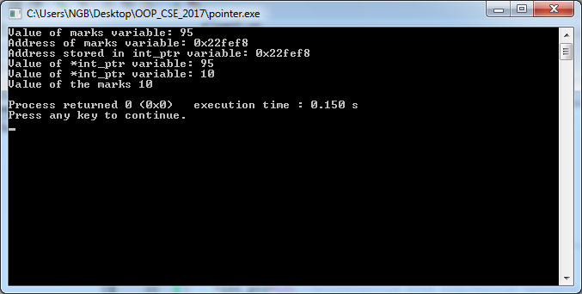
Output

Slide 6
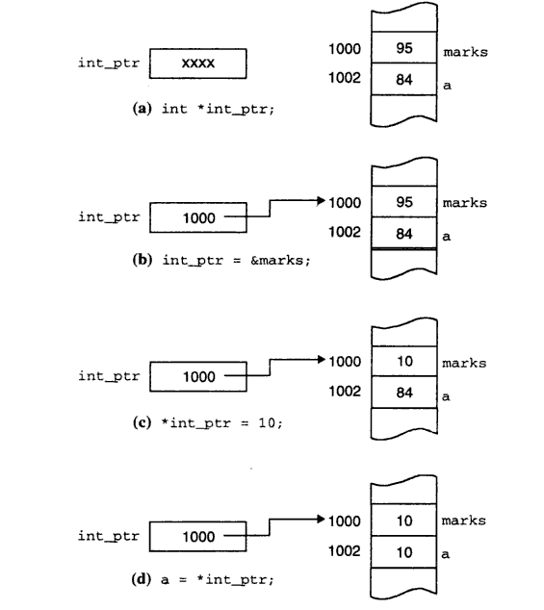
Explaining Pointer dereferencing

Slide 7
Void Pointer
It is dealing in unformatted memory. This is what malloc returns: a pointer to a block of memory of a certain size. Since the memory does not have a type (because it does not have a properly constructed object in it yet), it is typeless. i.e., void.
It is an opaque handle; it references a created object without naming a specific type.
Cannot be directly dereferenced without type casting to suitable types
Otherwise compiler error “(void *) is not a pointer-to-object type” will come

Slide 8
Program 2
#include <iostream>
using namespace std;
int main () {
int marks = 95;
float f=5.6; // actual variable declaration.
void *ptr=&marks;
ptr=&marks;
//cout<<*ptr;//compiler error
cout<<"typecasted to int: "<<*(int*)ptr<<endl;
ptr=&f;
cout<<"typecasted to float: "<<*(float *)ptr<<endl;
return 0;
}

Slide 9
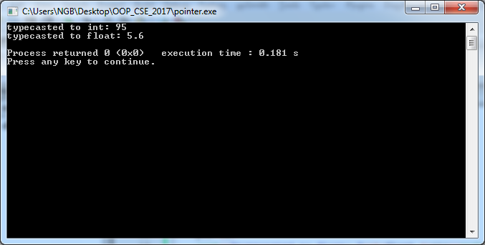
Output

Slide 10
Pointer Arithmetic
#include <iostream>
using namespace std;
int main () {
int *ptr, a[10]={0,1,2,3,4,5,6,70,8,9};
ptr=a;
for(int i=0;i<10;i++)
cout<<*(ptr+i)<<endl;
cout<<"First element "<<*ptr<<endl;
ptr=ptr+5;
cout<<"after +5 "<<*ptr<<endl;

Slide 11
Continued..
ptr--;
cout<<"after decrementing "<<*ptr<<endl;
ptr++;
cout<<"after incrementing "<<*ptr<<endl;
cout<<"multiplicating *ptr and *(ptr+2) "<<*ptr * *(ptr+2)<<endl;
cout<<"multiplicating *ptr and (*ptr+2) "<<*ptr * (*ptr+2)<<endl;
//ptr=ptr*2; //not valid
//ptr=ptr/2;//not valid
return 0;}

Slide 12
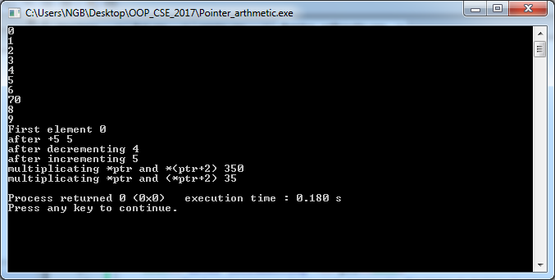
Output

Slide 13
Passing arrays or strings as arguments to functions
#include<iostream>
using namespace std;
void display(int *p,int n) //int * p= arr
{
for(int i=0;i<n;i++)
cout<<"address "<<(p+i)<<" value "<<*(p+i)<<endl;
}
void display_string(char *p, int n) //char *p=s
{
for(int i=0;i<n;i++)//p[i]!='\0'
cout<<*(p+i);
}

Slide 14
Continued
int main(){
int arr[]={1,2,3,4,5,6};
int n1=sizeof(arr)/sizeof(arr[0]);
char s[]="abcdef";
int n2=sizeof(s)/sizeof(s[0]);
display(arr,n1);
display_string(s,n2);
return 0;
}

Slide 15
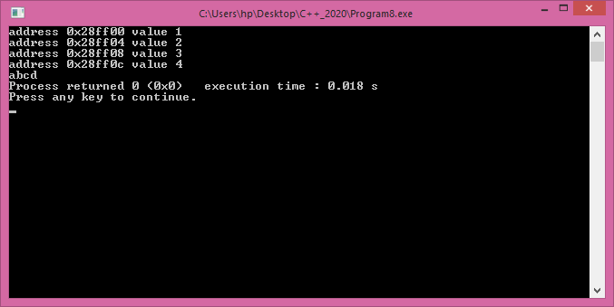
Output

Slide 16
new operator
int *m = new int(10); // initialization with new()
cout << *m;
// Pointer initialization to null
int* p = NULL;
// Request memory for the variable
// using new operator
p = new int;

Slide 17
Continued..
// Store value at allocated address
// *p = 29;
cout << "Value of p: " << *p << endl;

Slide 18
Continued..
// Request block of memory
// using new operator
float *r = new float(75.25);
cout << "Value of r: " << *r << endl;
// Request block of memory of size n
int n = 5;
int *q = new int[n];

Slide 19
Continued..
for (int i = 0; i < n; i++)
q[i] = i+1;
cout << "Value stored in block of memory: ";
for (int i = 0; i < n; i++)
cout << q[i] << " ";
// freed the allocated memory
delete p;
delete r;
// freed the block of allocated memory
delete[] q;

Slide 20
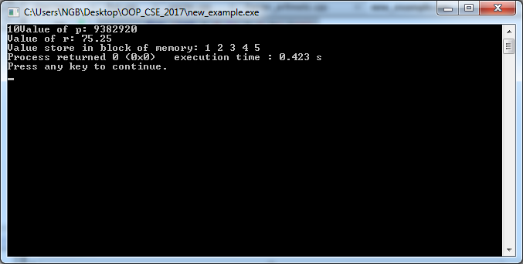
Output

Slide 21
new/delete vs malloc/free
new/delete operator
Returns a fully typed pointer.
new (standard version) never returns a NULL (will throw on failure)
Are called with Type-ID (compiler calculates the size)
Has a version explicitly to handle arrays.
Reallocating (to get more space) not handled intuitively (because of copy constructor).
Whether they call malloc/free is implementation defined.
Can add a new memory allocator to deal with low memory (set_new_handler)
operator new/delete can be overridden legally
constructor/destructor used to initialize/destroy the object

Slide 22
new/delete vs malloc/free
malloc/free function
Returns a void*
Returns NULL on failure
User must specify the size required in bytes.
Allocating array requires manual calculation of space.
Reallocating larger chunk of memory simple (No copy constructor to worry about)
They will NOT call new/delete
No way to splice user code into the allocation sequence to help with low memory.
malloc/free can NOT be overridden legally

Slide 23
Example Program
#include<iostream>
using namespace std;
int main(){
int * a=new int[-1];
return 0;
}

Slide 24
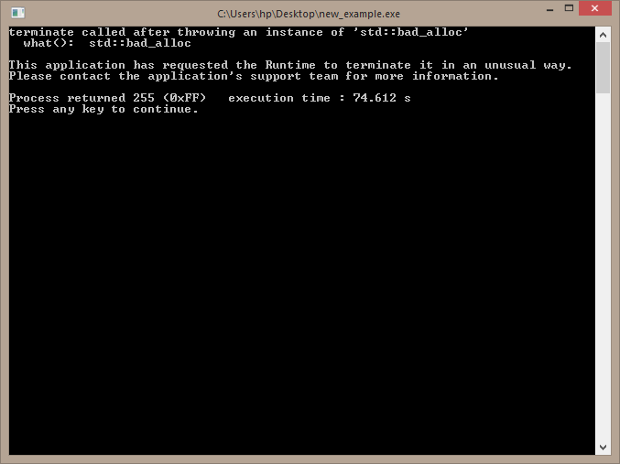
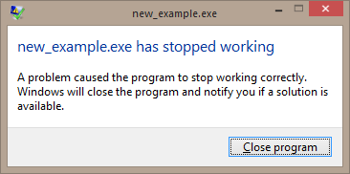
Exception

Slide 25

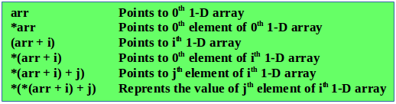
How pointers and array indexes are interlinked

Slide 26
Multi dimensional array
#include<iostream>
using namespace std;
int main(){
int **a=new int*[2];
for(int i=0;i<2;i++)
a[i]=new int[3];
cout<<"Enter Input"<<endl;
for(int i=0;i<2;i++)
for(int j=0;j<3;j++)
cin >> *(*(a+i)+j);

Slide 27
Continued..
for(int i=0;i<2;i++)
{
for(int j=0;j<3;j++)
{cout << *(*(a+i)+j)<<" ";} *(a+i)
cout<<endl;
}
for(int i = 0; i < 3; ++i) {
delete [] a[i];
}
delete [] a;
return 0;}

Slide 28
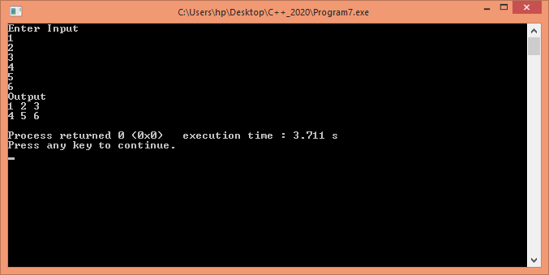
Output

Slide 29
Pointer to an array vs array of pointers
int p[2][3]={{1,2,3},{3,4,5}};
int (*c)[3];
c=p;
for(int i=0;i<2;i++)
for(int j=0;j<3;j++)
cout<<c[i][j]<<endl;
Array of pointers
int *c[3];

Slide 30
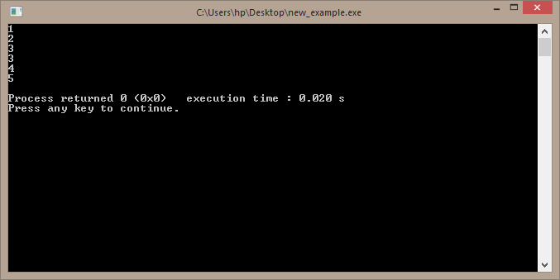
Output

Slide 31
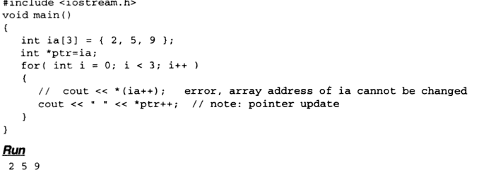
Program 5

Slide 32

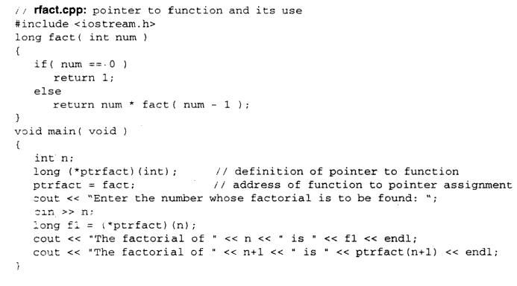
Pointer to Function

Slide 33
Constant pointer
int r=7;
int const *q=&r;//same as const int *q=&r;
cout<<q<<endl<<*q<<endl;
cout<<"after"<<endl;
//*q=10; //assignment of read-only location '*q'
//r=100;
q++;
cout<<q<<endl<<*q;

Slide 34
Continued..
int * const s=&r;
cout<<s<<endl<<*s<<endl;
cout<<"after"<<endl;
*s=200;
//s++;//increment of read only variable s
const int * const t=&r;
//*t=100;//assignment of read-only location '*(const int *)t'
//t++;//increment of read-only variable t

Slide 35
Returning pointer from a function
int * func(int n){
//int arr[n];
static int arr[100];
for(int i=0;i<n;i++)
arr[i]=i+1;
return arr;
}

Slide 36
Continued..
int main(){
int n, *ptr;
cout<<"enter value of n"<<endl;
cin>>n;
ptr=func(n);
for(int i=0;i<n;i++)
cout<<*(ptr+i)<<" ";
return 0;
}

Slide 37
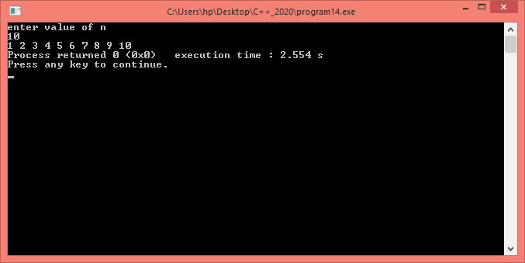
Output

Slide 38
Wild Pointer
Write the cases when a pointer becomes wild!
H.W.

